Slide 1


Team G27
Own the Second Purchase
From transactional dupe to trusted lifestyle brand, with the same $120M
24% → 31%
−12 to −14%
$0
90-day repeat
blended CAC
new budget
Retargeting and lifecycle strategy · Grounded in Adobe Customer Journey Analytics
Case Competition World Cup · Graduate Track · October 2026

Slide 2








Shift $9M to Owned Channels to Drive Profitable Retention
G27
Macro risk
The pivot
$62 CAC (+29%)
Quince Passport
Material Journeys
Gifting Ledger
Meta and Google saturation threatens the unit economic model
3 owned-channel flagships · zero price-led retention
Customer insight
Execution
77% drop-off
$7.5M
Cart abandonment: likely price-to-quality skepticism, not UX friction
Self-funded reallocation, shielded by Adobe CJA incrementality testing
90-day repeat 24% → ~31% · Blended CAC −12 to −14%
$0 new budget
No price-led retention
Proven in CJA
Source: case Exhibits C, D, G, H, J; Adobe CJA (Quince case data view, Jan–Apr 2026); impact figures are team estimates.
Team G27 · 2
Notes:
45 seconds. Anchor the judges on the financial stakes: CAC is $62 and rising, and 77% of carts never become orders. Then the anti-dupe brand evolution: three owned-channel flagships, no discounts, funded by $7.5M moved inside the fixed budget and proven by Adobe CJA holdouts. Close on impact: repeat 24% to about 31%, CAC down 12 to 14%.

Slide 3


To Defend a $10B Valuation, Quince Must Evolve Beyond "Transactional Dupe"
G27
CAC is diverging from customer value
Where Quince must move
Index, two years ago = 100
today
target
CAC $62 (+29%)
130
120
Fast fashion / dupe culture
Legacy lifestyle ecosystem
110
Transactional · high churn
High trust · occasion buying
$48
100
LTV flat without retention gains
$10.1B valuation (Mar 2026) rests on the ecosystem, not on cheap sweaters
Two years ago
Today
Rented channels (60% of budget) suffer from compounding signal loss: iOS opt-in ~35–50%, Safari and Firefox block cookies
Discount-led retention trains customers to wait for sales, destroying the M2C margin
Source: case Exhibits B, G, H; Reuters (Mar 2026, $10.1B valuation); Adjust and AppsFlyer ATT benchmarks. LTV line is illustrative: the case gives one LTV point, held flat absent retention gains.
Team G27 · 3
Notes:
This is the hook. Quince's valuation is not built on selling cheap sweaters; it is built on becoming lifestyle infrastructure. Rented reach costs more every year while customer value stays flat unless Quince earns the second purchase. Discounts would only teach customers to wait.

Slide 4




77% Cart Abandonment Highlights a Quality Trust Gap
G27
Price signals quality
Customers pause, assuming premium cashmere at half price is too good to be true
Owned channels convert
App users after order one repeat 4.6× the 4.7% baseline
Stage 1 · Add to cart → order
Stage 2 · Post-purchase, weeks 1–4
Stage 3 · Loyalty
77%
5.6%
21.5%
Abandonment
Week-2 repurchase peak
App repeat rate
The weeks 1–4 window
Engaged buyers return at 5.6% vs ~1% for the rest; doubt sets in before the item arrives and most hear nothing
Standard ads don't fix trust; owned-channel education does
Source: Adobe CJA, Quince case data view, 1 Jan–30 Apr 2026, 60,000 people: Fallout (77% of cart adders never order), Cohort Table (week-2 repurchase), sequential segments (app after order one). Mechanisms are hypotheses the pilot tests.
Team G27 · 4
Notes:
Shift the blame from bad retargeting ads to human psychology. 77% of people who add to cart never order. After the first order, buyers we engage return at 5.6% in week two, against about 1% for buyers who hear nothing. App users after order one repeat at 21.5%. Standard ads don't fix trust; owned-channel education does.

Slide 5



3 Owned-Channel Engines Built for Cross-Category Adoption
G27
Quince Passport
Material Journeys
The Gifting Ledger
Mechanic
Mechanic
Mechanic
Exclusive early access to high-AOV category drops (Home, Luggage) for top-decile cohorts
Triggered post-purchase SMS on material origin (e.g. Mongolian cashmere) and fabric care, before the item arrives
Occasion-based CRM (birthdays, anniversaries) with curated, factory-direct jewelry and home gift guides
Target
Target
Target
Drive cross-selling into higher-value categories
Win the weeks 1–4 window: 5.6% engaged vs ~1%
Build credibility in high-consideration categories
+11 supporting programs (Appendix) · zero discounts · $0 new budget · every engine tested against a CJA holdout
Source: team strategy; Adobe CJA (Cohort Table, category repeat: Home 20.8% vs cashmere 13.7%; jewelry 19.5%); case Exhibit F (jewelry repeat driven by gifting).
Team G27 · 5
Notes:
Three engines, each built for cross-category adoption. Pitch the Gifting Ledger as the ultimate weapon for jewelry and home goods: categories where occasion buying is critical but Quince currently lacks authority. In CJA, Home buyers repeat at 20.8% against 13.7% for cashmere, so the second order has to come from a new category.

Slide 6




Building a "Time-to-Copy" Moat Against Fast Fashion
G27
Price premium
CUYANA
Value pricing
Value + relationship
Transactional
Relationship-driven
Time-to-copy for competitors
Match a 20% discount code
1 day
Replicate a 12-month triggered lifecycle CRM
9–12 months
Anyone can undercut a price; nobody can instantly fake an integrated, educational customer relationship
Source: case Exhibit M; Shein acquisition of Everlane (May 2026); positions and time-to-copy are team estimates.
Team G27 · 6
Notes:
Anyone can undercut a price: a discount code takes a day to match. A triggered, educational lifecycle program built on a consented customer base takes nine to twelve months to replicate. Quince moves from value-and-transactional to value-and-relationship, the quadrant fast fashion can't reach quickly.

Slide 7




Evolving from Batch-and-Blast to Logistics-Integrated Pods
G27
Global factory and fulfillment APIs
Cross-functional retention pod
Triggered lifecycle workflows
Ship · in transit · delivered events
Marketing + merch, one owner per lever
SMS · email · app
Customer Journey Analytics stitched person ID · audiences for every trigger · holdouts on every program
Requires shifting from siloed channel owners to cross-functional pods
Readiness
Success depends on wiring factory shipping milestones directly into marketing triggers (Material Journeys)
Data and identity
Ready
Lifecycle team and creative
Build
Shipping events → triggers
Integrate
Incentives: ROAS → incrementality
Change
Quince's edge is cross-border logistics; marketing plugs into that data
Source: team operating model; case Exhibits I and L (CJA stitched person ID across web, app, email, SMS); readiness is team assessment.
Team G27 · 7
Notes:
This is where you win the judges. Quince's magic is cross-border logistics: direct factories to the door. Marketing must plug into that supply chain data so Material Journeys can fire on real shipping milestones. That means moving from siloed channel owners to a cross-functional retention pod, with Adobe CJA's stitched person ID underneath every trigger.

Slide 8
A Reversible, Self-Funded $7.5M Reallocation Pilot
G27
9-month rollout
M0
M3
M6
M9
Customer Journey Analytics
Holdout control group
Material Journeys
M1–3 · Low tech lift
South buyers
Quince Passport
M4–6 · Merch alignment
Gifting Ledger
M7–9 · App + CRM integration
90% pilot
new journeys
10% holdout
business as usual
Reallocation inside the fixed $120M
Paid social retargeting
−$4M
Tranche 1 · M1–3
Paid search
−$3M
Tranche 2 · after geo holdout
>200bps?
Paid social prospecting
−$2M
Tranche 3 · only if proven
Yes: money stays moved
No: tranche returns
Influencer → proof creators
+$1.5M
With tranche 2
Owned: email, SMS, app
+$7.5M
Retention pod and engines
Shift $4M from paid social retargeting to retention in tranche 1. Strict guardrail: no permanent move unless CJA holdouts prove >200bps incremental lift. Track repeat, blended CAC, retargeting efficiency.
Source: case Exhibit G (budget); team plan. Tranche 2 needs a branded-search geo holdout; tranche 3 moves only if a holdout proves prospecting over-credited.
Team G27 · 8
Notes:
Emphasise the word pilot. Tranche 1 moves $4M out of paid social retargeting in months 1 to 3. Nothing becomes permanent unless the Adobe CJA holdout shows more than 200 basis points of incremental lift on 30-day repeat. That solves the internal political battle: the data decides whether the money stays moved.

Slide 9
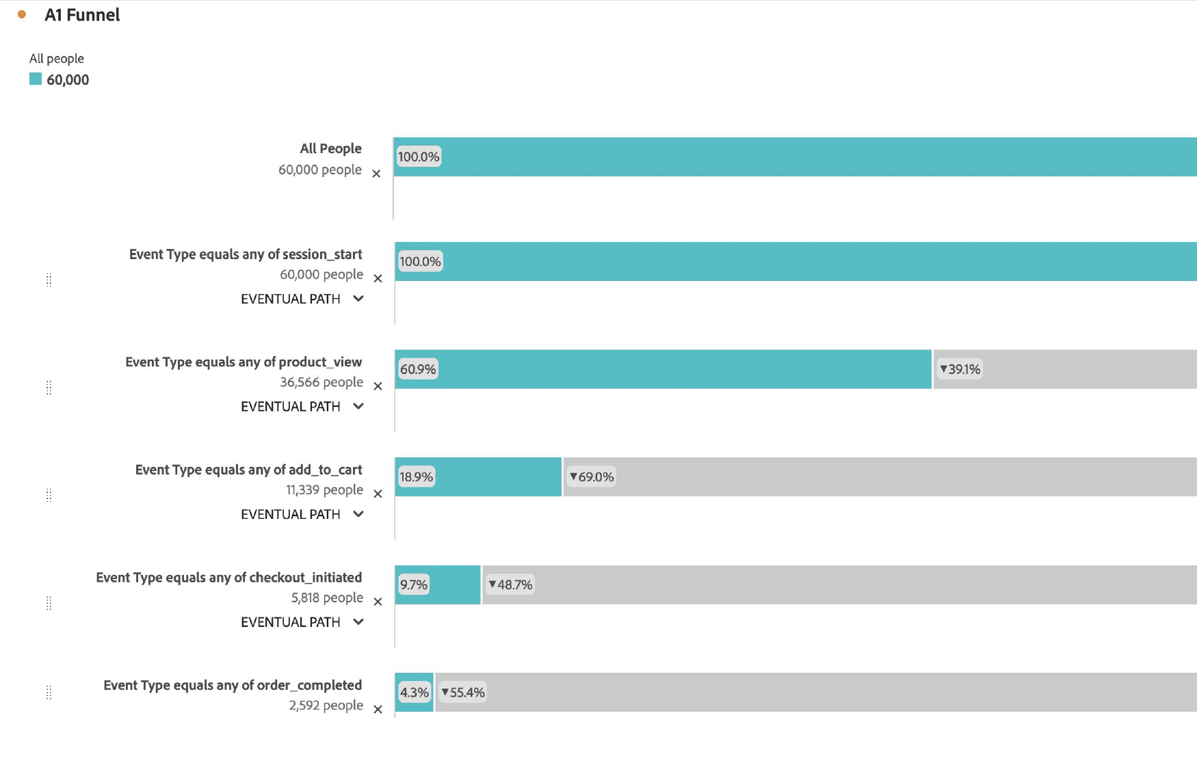
A1 · Adobe CJA Fallout: the bottleneck is the cart
G27
If asked: "Are you sure the bottleneck is the cart and not the landing page?"
60,000 people → 2,592 buyers: 39% leave before a product view, but 77% of cart adders never order, the stage that sits above benchmark
Source: Adobe CJA, Fallout visualization, Quince case data view, 1 Jan–30 Apr 2026.
Team G27 · 9

Slide 10
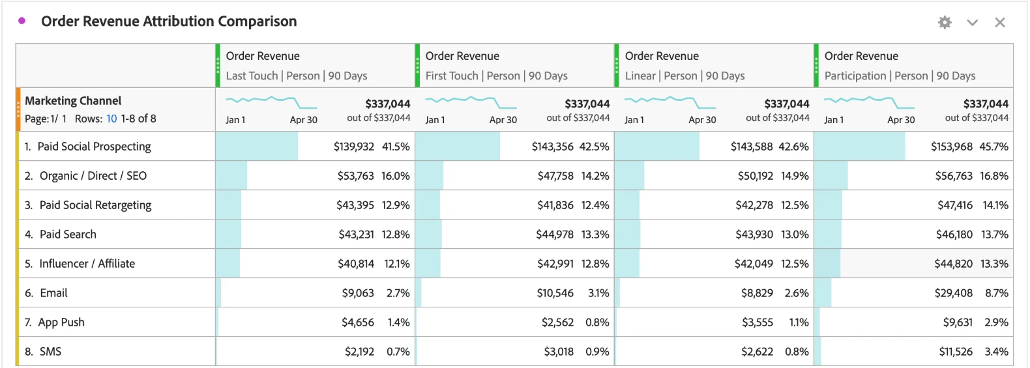
A2 · CJA Attribution IQ: owned channels are under-credited
G27
If asked: "Why pull $4M from paid social?"
Owned channels take part in 15.0% of revenue but get 4.8% on last touch; retargeting stays ~12.5% under every model, so its cut rests on holdouts
Source: Adobe CJA, Attribution panel, Order Revenue ($337,044) across Marketing Channel, four models, 90-day lookback.
Team G27 · 10

Slide 11
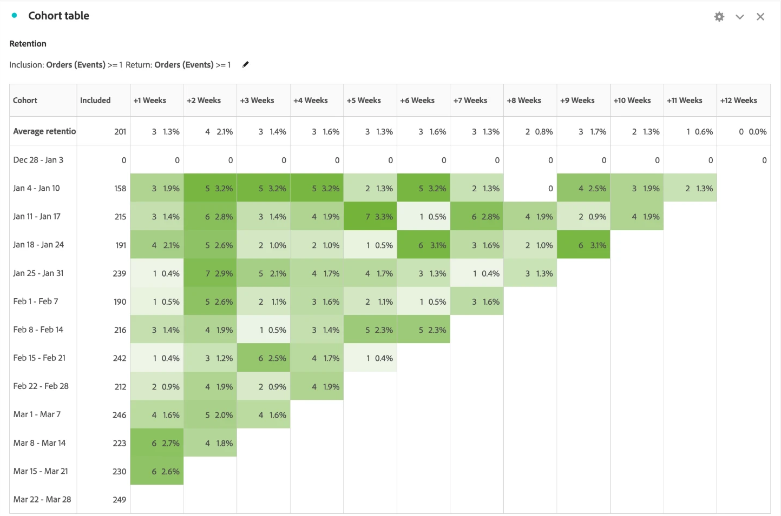
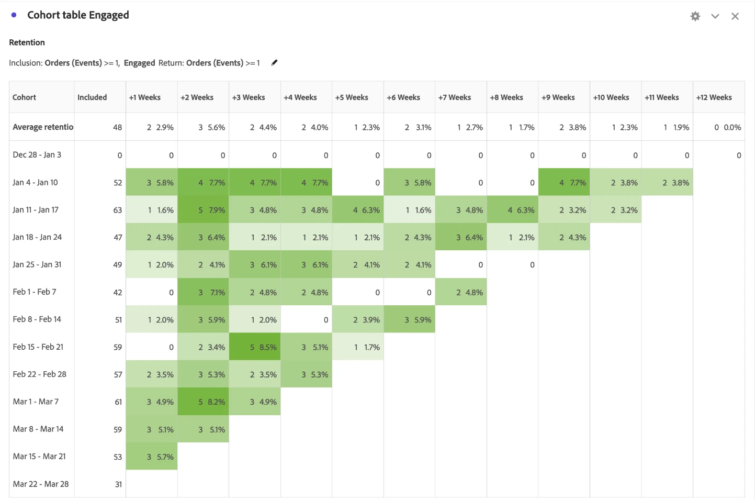
A3 · Adobe CJA Cohort Table: the weeks 1–4 window
G27
If asked: "Why act in the first month?"
Week-2 repurchase: 5.6% for engaged buyers (right) vs 2.1% for all buyers (left); half of engaged returns land in weeks 1–4
Source: Adobe CJA, Cohort Table, inclusion and return Orders ≥ 1, weekly; right panel uses the Engaged inclusion segment.
Team G27 · 11

Slide 12
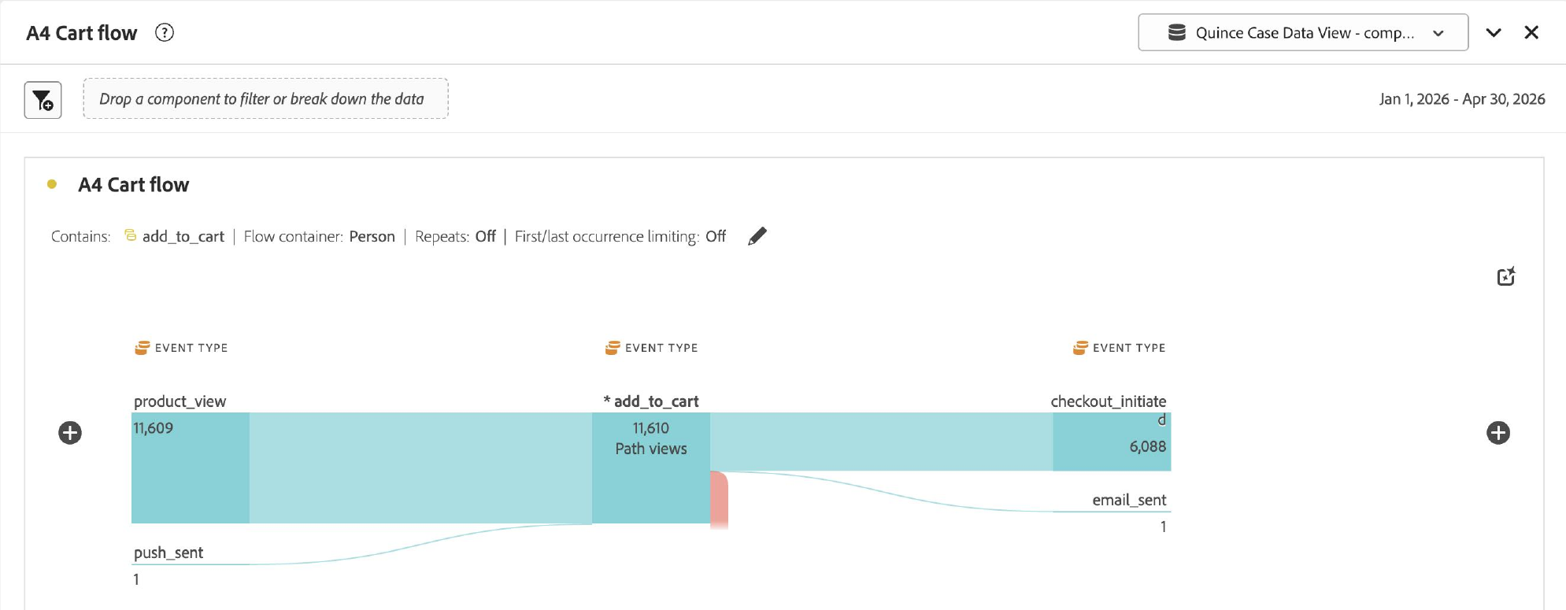
A4 · Adobe CJA Flow: no message follows an abandoned cart
G27
If asked: "Doesn't Quince already email cart abandoners?"
Of 11,610 add-to-cart paths, 6,088 reach checkout and 1 is followed by an email; the rest get no message at all
Source: Adobe CJA, Flow from add_to_cart, Person container, 1 Jan–30 Apr 2026.
Team G27 · 12

Slide 13




A5 · Logistics Integration Roadmap for Material Journeys
G27
If asked: "How hard is Material Journeys to actually build?"
Factories and 3PL partners
Shipment created · customs cleared · out for delivery · delivered
Build sequence
1
Weeks 1–4
Order and fulfillment API
One event stream per order, keyed to the order ID
Map shipping events; confirm consent split
Adobe CJA: stitched person ID
Order ID → person; audiences; holdout assignment
2
Weeks 5–8
Stream events into CJA; build audiences
Journey orchestration
Pre-arrival care · delivery-day Passport ask · day-21 cross-sell
3
Weeks 9–12
Launch pre-arrival journeys in the South pilot
Channels
SMS · email · app push, under one frequency cap
Low tech lift: the shipping events already exist; the work is routing them to CJA audiences and lifecycle triggers
Source: team architecture; Adobe CJA and Journey Optimizer as the activation layer (case Exhibit L). Timings are team estimates.
Team G27 · 13

Slide 14











A6 · Cutting Room Floor: 11 Programs Behind the 3 Flagships
G27
If asked: "What else did you consider?"
Track It in the App
Saved Cart
Restock-First Waitlist
Care Calendar
Default effect
Unfinished-task reminders
Commitment
Habit formation
Quince Insider
Beauty Refill
Cashmere Second Life
Never Pay Twice Engine
Access, not points
Replenishment cue
Take-back for early access
Suppress owned buyers in ads
14 → 3
programs considered → flagships on slide 5
Loyalist Lookalikes
Proof Creators
The Fitting Room
Seed prospecting on repeaters
Social proof
Members-only pop-up
All 14 are zero-discount; the 3 flagships won on cross-category reach and build effort, the other 11 plug into them
Source: team strategy. All 14 programs were designed with zero discounts; the 3 flagships were chosen for cross-category reach and build effort.
Team G27 · 14

